Slide 1
Classification – Fundamentals & Practical Applications
YES
NO

Slide 2

Course Learning Objectives
Understand what Classification is and its applicability to many real-world scenarios
Perform simple classification tasks using logistic regression in Excel
Understand the implicit assumptions behind Classification techniques and algorithms
Create classification models in Python using statsmodels and sklearn modules
Interpret and evaluate the performance of classification models, outputs and parameters
Explore more advanced evaluation techniques such as PDP plots and SHAP values to expand your horizons.
Notes:
This is for the course landing page and student handout PFD. The instructor does not need to record this slide.

Slide 3
Classification Basics
YES
NO

Slide 4
What Is Classification?
A classification problem involves classifying data into different labels or categories
The target categories should be discrete variables
Predictions are made using one or more input variables
Errors
Typos
Domain
Strokes
Variation
Form
Credit
Income
Status
Spam Detection
Signature Analysis
Loan Default
Inbox
Spam
Genuine
Forged
Default
Not Default

Slide 5
Recap: The Machine Learning Ecosystem
There are four main types of Machine Learning algorithms:
Supervised Machine Learning
…uses labelled datasets to train algorithms in classifying data
Unsupervised Machine Learning
…uses unlabelled datasets to train algorithms in classifying data
Classification
Regression
Clustering
Association
Reinforcement Learning
…uses reward maximization such that the algorithm determines the optimal behaviour in an environment
Deep Learning
…learns data patterns and structure from the data itself and is scalable to big data. It can be used for supervised and unsupervised learning
Notes:
C0L04 – What is Regression?
Slide 3

Slide 6
Types of Classification
Binary
Classification tasks that have two class labels
Outcomes must be ONE of the two classes
Algorithm that only deals with binary classification include Logistic Regression and Support Vector Machines
Use Case | Input Variables | Output Classes
Tumour diagnosis | Variation, Texture, Contrast, Growth Rate etc | Malignant OR Benign
Customer Prediction | Purchase History, Click history, Customer Profile | Will Buy OR Will Not Buy
Email Spam Detection | Spelling Errors, Grammatical Errors, Email domain | Spam OR Not Spam

Slide 7
Types of Classification
Multi-Class
Has more than two class labels
Outcomes must be ONE of a range of classes
Algorithm suited for multi-class problems include decision trees and random forests.
Use Case | Input Variables | Output Classes
Tumour diagnosis | Variation, Texture, Contrast, Growth Rate etc | Malignant OR Benign OR Premalignant
Customer Prediction | Purchase History, Click history, Customer Profile | Will Buy OR Will Not Buy OR Insufficient Data
Email Spam Detection | Spelling Errors, Grammatical Errors, Email domain | Spam OR Not Spam OR Unsafe

Slide 8
Types of Classification
Multi-label
Has two or more class labels
Outcome can be ONE or MORE of the class labels
Difference between multi-label and multi-class is that each label in the former one represents a different but related classification problem
Use Case | Input Variables | Output Classes (Labels)
Tumour diagnosis | Variation, Texture, Contrast, Growth Rate etc | Malignant OR /AND Benign OR / AND Premalignant
Customer Prediction | Purchase History, Click history, Customer Profile | Will Buy OR / AND Will Not Buy OR / AND Insufficient Data
Email Spam Detection | Spelling Errors, Grammatical Errors, Email domain | Spam OR / AND Not Spam OR / AND Unsafe
For example, a multi-label classifier may classify an email as both spam and unsafe, or classify the tumor as both benign and premalignant

Slide 9
Common Classification Use Cases
Binary
Machinery Outage Prediction - Failure OR Not Failure
Anomaly Detection – Fraud OR Not Fraud
Credit Card Default - Customer Likely to Default OR Not Likely to Default
Multi-Class
Product Classification – Red Wine OR White Wine OR Rose Wine
News Classification of Articles – Sports OR Lifestyle OR Economy OR Current Affairs
Facial Image Recognition – Happy OR Sad OR Angry
Multi-Label
Social Tag Selection - #TogetherAtHome OR / AND #COVID19 OR / AND #WorkFromHome

Slide 10
Visualizing Classification
For simple scenarios, it can help to visualize the input variables and output classes on a chart.
Two Classes
Class 1: Spam
Three Classes
Class 1: Spam
Class 2: Not Spam
Class 2: Not Spam
Class 3: Unsafe
Grammatical Errors
Grammatical Errors
Malicious Content
Malicious Content
In each case, the goal is to use the input data to separate the classes as cleanly as possible.

Slide 11
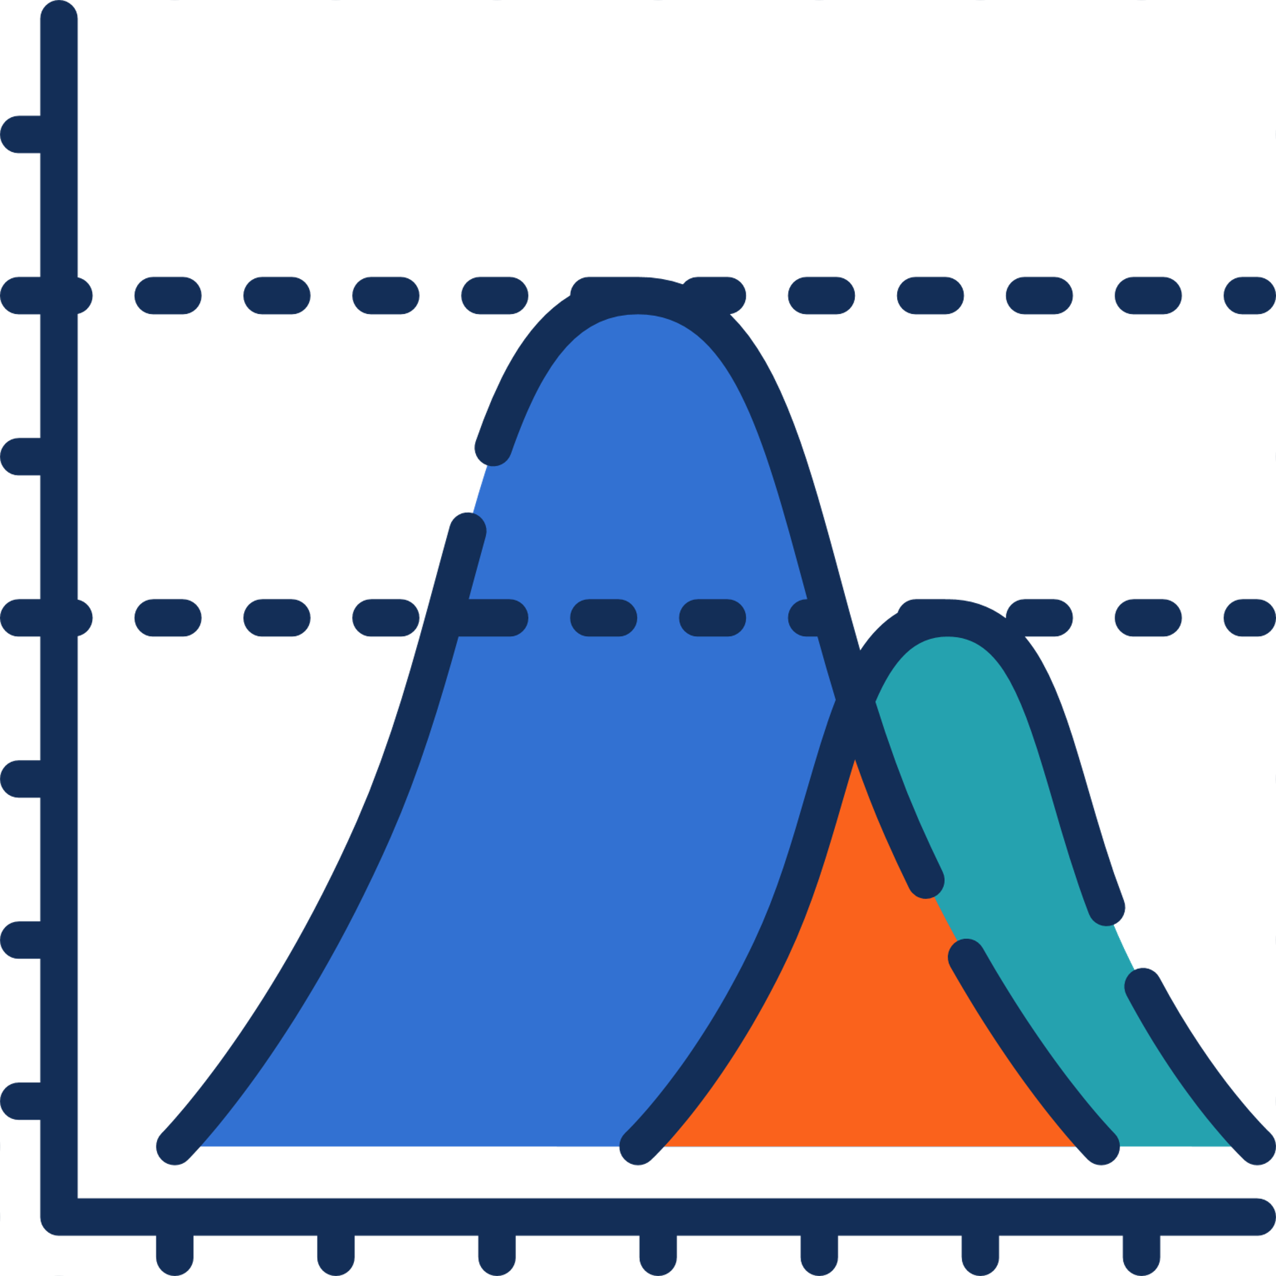

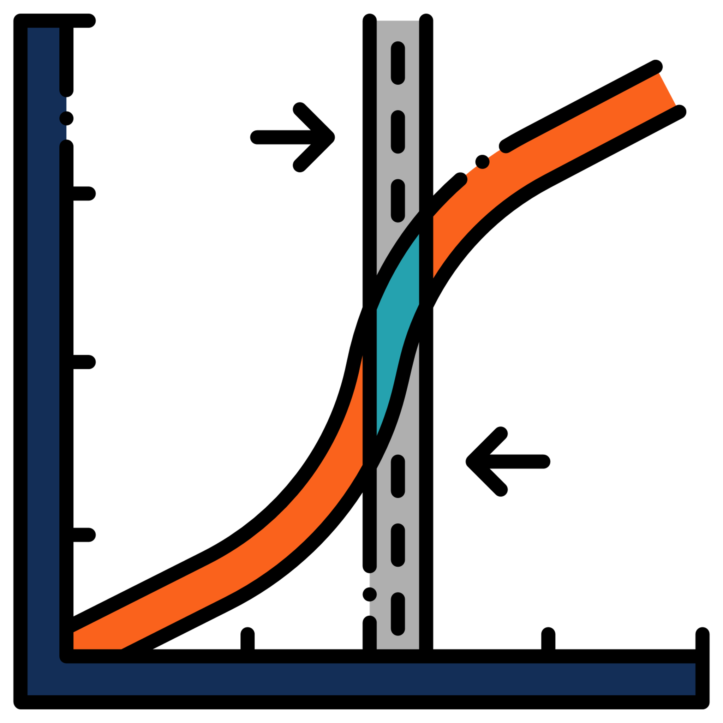

Classification Algorithms
Throughout the course, we’ll explore the most common classification algorithms.
Logistic Regression
Naïve Bayes
KNN
SVM
Decision Trees
Random Forest
Uses regression principles to achieve separation between discrete classes
We will look at the benefits of each and how to interpret and evaluate the outputs.

Slide 12
Logistic Regression

Slide 13
Logistic Regression
Understand and learn the fundamental concepts of Logistic Regression
Understand and calculate the probabilities, log odds and how these impact model interpretation
Learn how to interpret log odds and the assumptions behind Logistic regression
Be comfortable with the mathematics behind Logistic Regression and how to manipulate it
Be able to comprehend and interpret the outputs of logistic regression algorithm for business scenarios.
Practice a basic logistic regression example in Excel and Python.
Notes:
This is for the course landing page and student handout PFD. The instructor does not need to record this slide.

Slide 14
Chapter Overview
Logistic Regression is one of the simplest types of classification algorithms.
It estimates discrete values (Binary values like 0/1, yes/no, true/false) based on a given set of the independent variable(s)
In this chapter we will cover:
What is logistic regression?
How does it work?
Practical demonstrations in both Excel and Python

Slide 15
Logistic Regression
Logistic regression makes a classification based on the probability of an event happening.
“What is the probability that this customer will purchase medical supplies?"
50%
50%
50%
48%
35%
80%
0%
100%
0%
100%
0%
100%
Customer 1
Customer 2
Customer 3
Prediction: Will Not Buy
Prediction: Will Buy
Prediction: Will Not Buy
We determine a threshold (typically 0.5 or 50%) as the cut off between prediction classes.​
In this case: customers lower than the threshold are predicted to NOT buy.
​customers higher than the threshold are predicted to WILL buy.
Notes:
Probability is the term used to determine how likely is it for an outcome to happen.
For instance, there is 1 in 6 probability that you will get a 2 when rolling a die

Slide 16
Logistic Regression
Changing the threshold will change the prediction class of some observations.
40%
40%
40%
48%
35%
80%
0%
100%
0%
100%
0%
100%
Customer 1
Customer 2
Customer 3
Prediction: Will Not Buy
Prediction: Will Buy
Prediction: Will Not Buy
Prediction: Will Buy
We can use evaluation metrics to help us decide on the most appropriate threshold.
Notes:
Probability is the term used to determine how likely is it for an outcome to happen.
For instance, there is 1 in 6 probability that you will get a 2 when rolling a die

Slide 17
Visualizing Logistic Regression
Logistic Regression probabilities are estimated using one or more input variables
1
1
Customers who DID buy medical supplies
Predict NOT BUY
0.75
Probability of Buying (Y)
0.5
Predict BUY
0.25
Not Buy
Buy
0
0
Customers who did NOT buy medical supplies
30
35
40
45
50
55
Customer Age (X)
Logistic Regression uses a curved line to summarize our observed data points
The logistic regression line generates probabilities between 0 and 1.

Slide 18
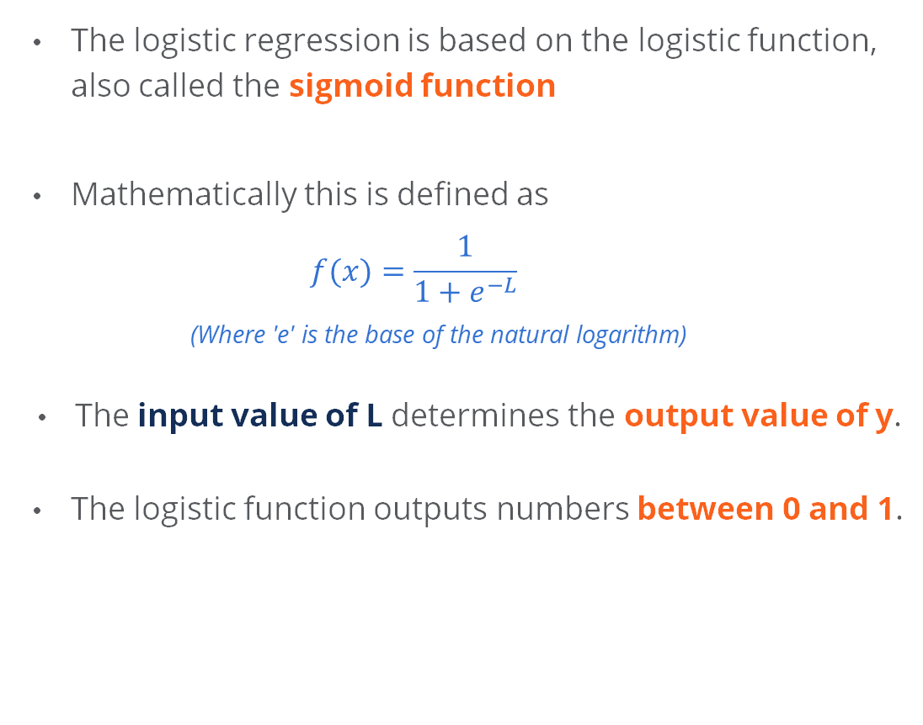
Defining the Logistic Regression Curve
The logistic regression is based on the logistic function, also called the sigmoid function
Mathematically this is defined as
$$f(x)=\frac{1}{1+e^{−L}}$$
(Where 'e' is the base of the natural logarithm)
The input value of L determines the output value of y.
The logistic function outputs numbers between 0 and 1.
(Y)
1.0
0.5
-6
-3
0
3
6
(L)
At input (L) 0, output (y) = 0.5.
As input (L) increases, output (y) increases.

Slide 19
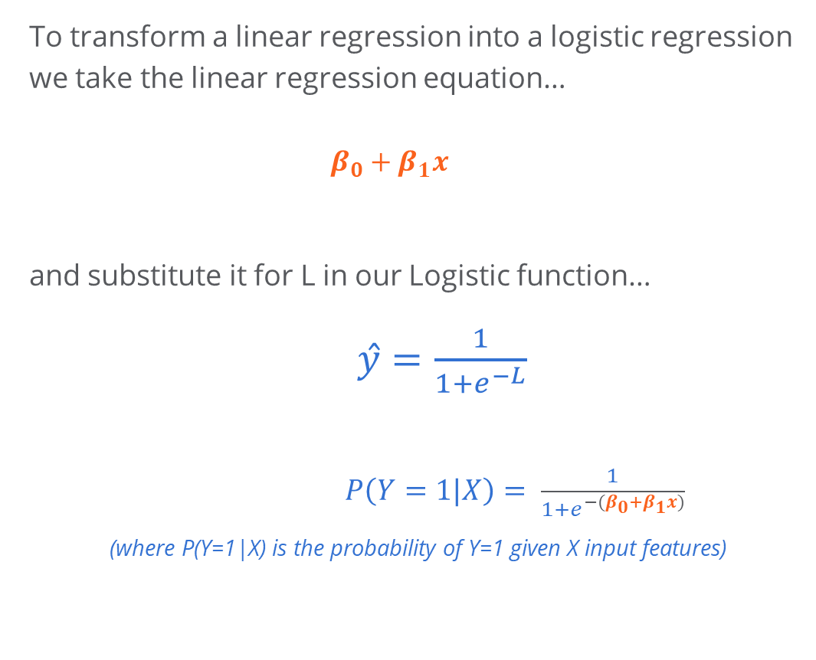
Defining the Logistic Regression Curve
To transform a linear regression into a logistic regression we take the linear regression equation…
$$β_{0}+β_{1}x$$
and substitute it for L in our Logistic function…
$ŷ=\frac{1}{1+e^{−L}}$
$P\left(Y=1|X\right)= \frac{1}{1+e^{−(β_{0}+β_{1}x)}}$
(where P(Y=1|X) is the probability of Y=1 given X input features)
1
0.75
0.5
Target Variable (Y)
0.25
0
0
5
10
15
20
25
Independent Variable (X)
The logistic curve has been transformed to fit the input data.

Slide 20
Summary of Logistic Vs Linear Regression
Logistic Regression
Linear Regression
1
1
0.75
Logistic regression provides a better fit
0.75
Linear regression poor fit for classifying data
Probability (Y)
Probability (Y)
0.5
0.5
0.25
0.25
0
0
0
5
10
15
20
25
0
5
10
15
20
25
Independent Variable (X)
Independent Variable (X)
Probabilities always sit between 0 and 1.
More suitable for predicting a binary outcome.
More suitable for Classification.
Probabilities are not limited to a sensible range.
Suited to predicting number of something.

Slide 21
Logistic regression assumptions
The dependent variable is binary i.e. fits into one of two clear-cut categories
There should be no, or very little, multicollinearity between the predictor variables— meaning the independent variables should be independent of each other
Logistic regression requires large sample sizes—the larger the sample size, the more reliable the results
The independent variables should be linearly related to the log odds
With multicollinear variables, the algorithm would be unable to separate their effects​ likely causing errors
Tumour Density
Size
Mass
Multicollinearity would happen because size and mass hold similar information.

Slide 22
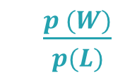
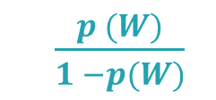
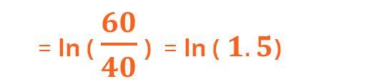
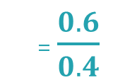
Probability, Odds and Log Odds
Win p = 60%
Lose p = 40%
Probabilities are the chance of something happening, relative to all outcomes.
W
W
W
W
W
W
L
L
L
L
Odds are the chance of something happening, relative to other outcomes.
= $\frac{0.6}{0.4}$
Odds Of Winning
$\frac{p (W)}{p(L)}$
$\frac{p (W)}{1 −p(W)}$
= 1.5
=
=
Log Odds are simply the log of the odds.
Log odds are easier for statistical models to work with.
Log Odds Of Winning
= ln ( $\frac{60}{40}$ ) = ln ( $1.5$)

Slide 23
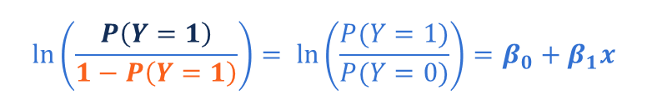
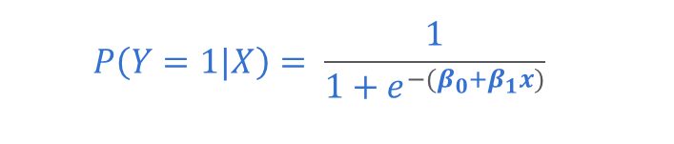
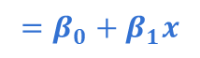
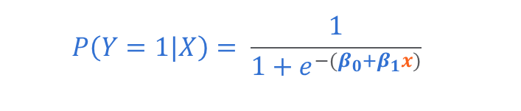
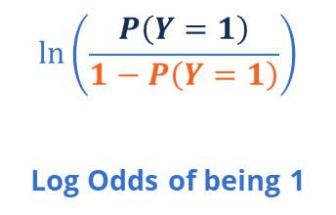
Logistic Probabilities, Odds and Log Odds
Interpreting the impact of a change in an input variable appears to be difficult at first.
$$P\left(Y=1|X\right)= \frac{1}{1+e^{−(β_{0}+β_{1}x)}}$$
Here x is our input variable.
Rearranging our logistic regression equation we can reach the following:
$$P\left(Y=1|X\right)= \frac{1}{1+e^{−(β_{0}+β_{1}x)}}$$
REARRANGE
$$\ln\left(\frac{P\left(Y=1\right)}{1−P\left(Y=1\right)}\right)= \ln\left(\frac{P(Y=1)}{P(Y=0)}\right)=β_{0}+β_{1}x$$
$$\ln\left(\frac{P\left(Y=1\right)}{1−P\left(Y=1\right)}\right)$$
Log Odds of being 1
$$=β_{0}+β_{1}x$$
Linear Inputs

Slide 24
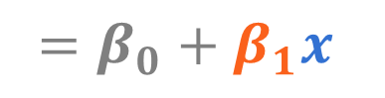
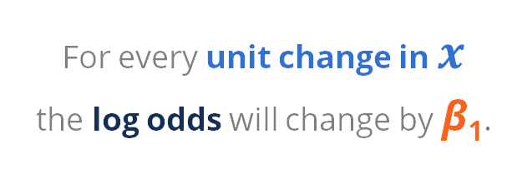
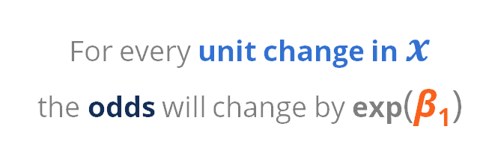
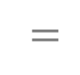
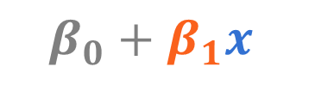
Interpreting Coefficients
We can interpret the coefficients in two ways:
Log ( )
exp ( )
Odds of being 1
$$=β_{0}+β_{1}x$$
Odds of being 1
$$=$$
$$β_{0}+β_{1}x$$
For every unit change in $x$ the log odds will change by β₁.
For every unit change in $x$ the odds will change by exp(β₁)
Odds are generally easier to interpret than log odds.

Slide 25
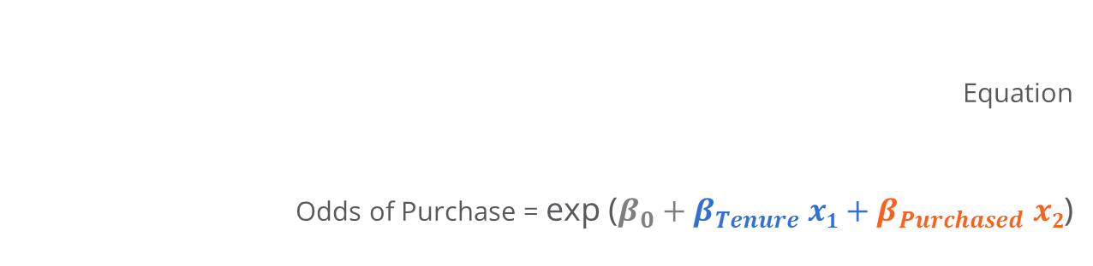
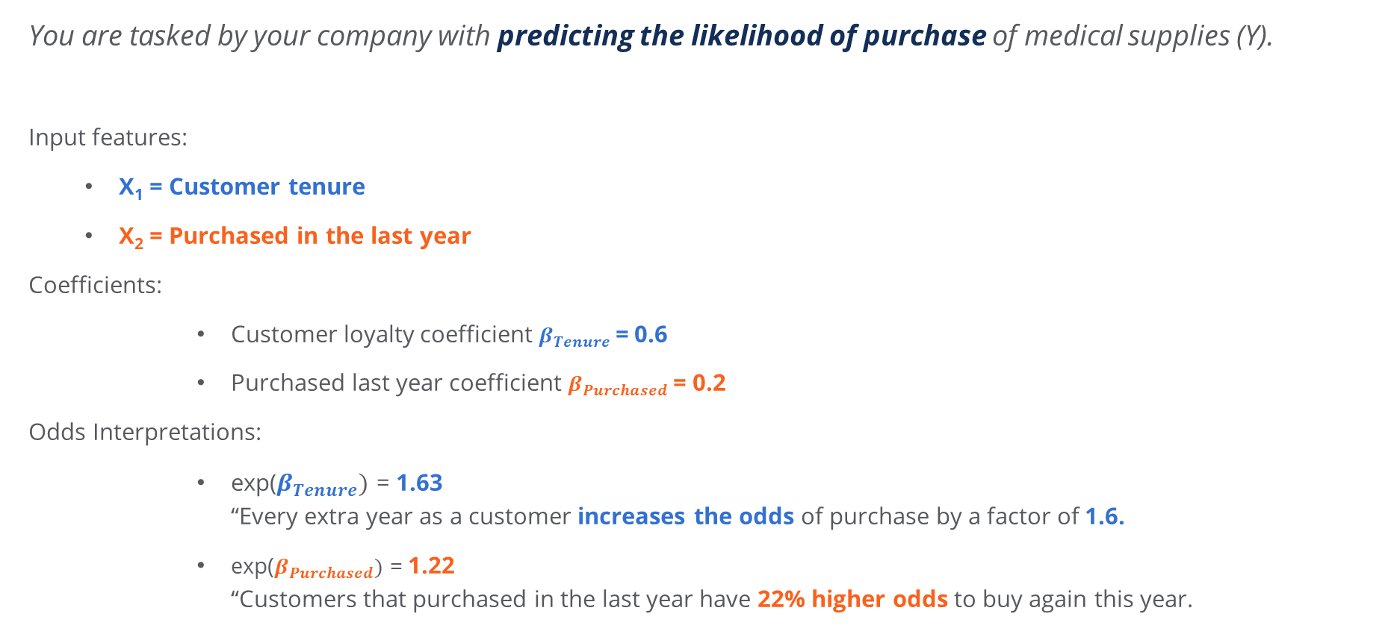
Interpretation Scenario
You are tasked by your company with predicting the likelihood of purchase of medical supplies (Y).
Input features:
X₁ = Customer tenure
X₂ = Purchased in the last year
Coefficients:
Customer loyalty coefficient $β_{Tenure}$= 0.6
Purchased last year coefficient $β_{Purchased}$= 0.2
Odds Interpretations:
exp⁡($β_{Tenure})$ = 1.63 “Every extra year as a customer increases the odds of purchase by a factor of 1.6.
exp⁡($β_{Purchased})$ = 1.22 “Customers that purchased in the last year have 22% higher odds to buy again this year.
Equation
Odds of Purchase = exp ($β_{0}+β_{Tenure} x1+β_{Purchased}$ $x2$)

Slide 26


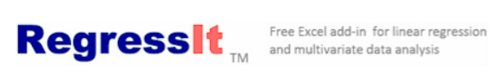
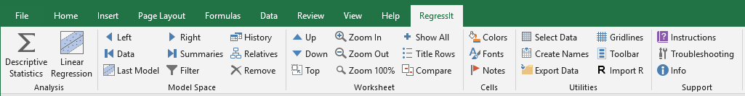
Logistic Regression in Practice
Excel
RegressIt is a powerful Excel add-in tool that performs multivariate descriptive data analysis and linear as well as logistic regression
Python packages
Scikit-learn provides a range of supervised and unsupervised learning algorithms
statsmodels provides classes and functions for many different statistical models and tests

Slide 27
Classification Algorithms

Slide 28
Classification Algorithms
YES
NO
Learn about the basic Classification algorithms and when and how to use them
Understand the underlying considerations and assumptions of these algorithms
Learn the inner workings of the algorithms and understand how they categorize observations
Understand how to interpret the parameters, outputs and evaluation metrics for the algorithms
Be able to apply these to real-world scenarios and learn about their applications
Apply each classification algorithm in Python identify the quality of results from each.
Notes:
This is for the course landing page and student handout PFD. The instructor does not need to record this slide.

Slide 29
Algorithms Overview
We will review five common algorithms used to build classification models:
Naïve Bayes
KNN
SVM
Decision Trees
Random Forest

Slide 30
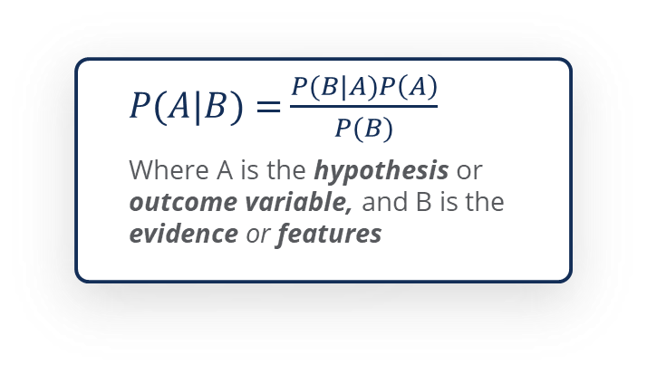
Naïve Bayes
Naïve Bayes is a probabilistic model based on Bayes theorem; it gives us classifications based on probabilities
Bayes theorem generates the probability of one event, given the probabilities of other events
Bayes Theorem states the probability (P) of an event A happening given that an event B occurred can be given by:
Strengths
Easy to use and good for large datasets
Can be used to solve multi-class prediction problems
Weaknesses
Assumes independence in features, which makes it less applicable on most real-world datasets
$P(A|B)$ = $\frac{P(B|A)P\left(A\right)}{P(B)}$
Where A is the hypothesis or outcome variable, and B is the evidence or features

Slide 31
Naïve Bayes – Example
We want to predict the likelihood of an email being spam, given it contains a grammatical error.
Observation | Spam Email? | Grammatical Errors?
1 | Yes | Yes
2 | No | No
3 | No | Yes
4 | No | No
5 | No | No
6 | Yes | No
7 | No | No
8 | No | No
9 | No | Yes
10 | No | No
… | … | …
20 Emails
Spam
Not Spam
Grammatical Errors
3
4
7
No Grammatical Errors
1
12
13
4
16
20
Notes:
Video 2

Slide 32
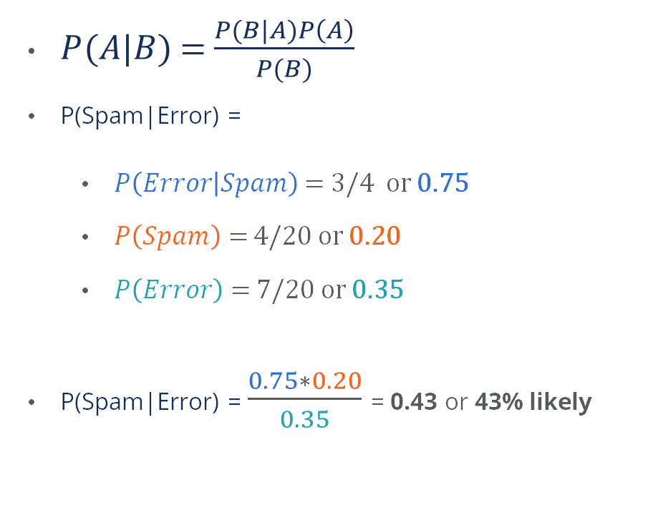
Naïve Bayes – Example
We want to predict the likelihood of an email being spam, given it contains a grammatical error.
$P(A|B)$ = $\frac{P(B|A)P\left(A\right)}{P(B)}$
P(Spam|Error) =
$P\left(Error | Spam\right)$ = 3/4 or 0.75
$P\left(Spam\right)=$ 4/20 or 0.20
$P\left(Error\right)=$ 7/20 or 0.35
P(Spam|Error) = $\frac{0.75∗0.20}{0.35}$ = 0.43 or 43% likely
20 Emails
Spam
Not Spam
Grammatical Errors
3
4
7
No Grammatical Errors
1
12
13
4
16
20
Notes:
Video 2

Slide 33
K-Nearest Neighbours (KNN)
KNN assigns output classes based on the most similar observations in our sample space.
By similar, we mean those who have the closest input values.
Two Classes
Class 1: Spam
New observation - Which class would you likely assign it to?
The new observation is closer to the Not Spam observations, meaning its characteristics are more similar.
Class 2: Not Spam
Not Spam!
Grammatical Errors Frequency (Y)
New observation - The nearest observation is Spam.
However, the next 3 closest are Not Spam.
How many of the nearest observations should we choose?
Malicious Content Frequency (X)
Once we have optimized this number of nearest neighbours, we can visualize our decision boundary, which represents the boundary between Spam and Not Spam.

Slide 34
K-Nearest Neighbours - Example
Choosing the right value for K is critical
K=1 will simply classify the data point on the basis of one closest neighbour
K=1000 will not identify categories in the data at all
Increasing K improves prediction due to averaging of the distance, the algorithm selects the most suitable point
An optimal value of K must be selected depending on the size of the dataset
p1
Misclassified labels
Feature (Y)
Class 1: Not Spam
Class 2: Unsafe
Class 3: Spam
p2
Feature (X)
As the misclassified point p1 (Not Spam) has a green point (Spam) closest, a value of K=1 misclassifies the Not Spam email as Spam.
The exact thing happens in the case of p2
Strengths
Simple and easy implementation (no assumptions)
Can be used for classification and regression
Weaknesses
Performance decreases as the number of examples and/or independent variables increases

Slide 35
Support Vector Machines (SVM)
In 2D sample space, separation is created using a line
In 3D sample space, separation is created using a plane
SVMs separate data points with a line or plane through the sample space
SVM aims to find a plane that maximises the separation distance between data points of both classes
The algorithm defines the criterion for a boundary that is maximally far away from any data point
This distance to the closest data point from the decision surface determines the margin of the classifier
Class 2
Class 1
Class 2
Class 1
Strengths
Uses a subset of training points in the decision function so it is memory efficient
Weaknesses
The algorithm does not directly provide probability estimates, these are calculated using expensive techniques

Slide 36
Decision Trees
A decision tree is a cascading set of questions, used to incrementally separate classes and improve predictive power.
Strengths
Simple to understand and interpret (visualise)
Used for classification or regression
Requires little data preparation as it can handle both numerical and categorical
Yes
No
Weaknesses
Tends to overfit (the trained tree doesn’t generalise well to unseen data)
Small changes in data tends to cause big difference in tree (instability)
Can become expensive to compute with high dimensionality
Yes
No

Slide 37
Decision Trees - Example
Spam: 4
Not Spam: 16
Each node represents a feature/attribute of the data set and branches represent a decision
The decision tree starts at the root node
We go down the tree asking true/false questions at decision nodes…
…until the leaf node (or outcome) is reached
Once the tree is completed, it can be used to evaluate each email by answering the questions until a leaf node is reached and a prediction is made.
Grammatical Error?
Yes
No
Spam: 3
Not Spam: 4
Spam: 1
Not Spam: 12
Yes
No
Notes:
We can continue doing this, adding more and more features to gradually improve our model. If we get to the end of a branch, and we can’t improve the segmentation of loan-defaults, we stop.
The nodes where we stop are called leaf nodes. The node where we started is called the root node, and all nodes in-between are called decision nodes. To choose which node is added first or next, we simply choose the next available feature that best separates defaults from non-defaults.
With a completed tree, each customer loan can be evaluated using the tree, and by answering the questions, until we reach a leaf node and make a prediction.

Slide 38
Decision Trees - Example
20% Spam
Spam: 4
Not Spam: 16
Splitting is the process of dividing a node into child nodes
The goal is to make each of the child nodes more “pure” or homogenous – containing more similar classes of observations
Separating emails according to grammatical errors adds predictive value to the model
Grammatical Error?
43% Spam
Yes
No
7.7% Spam
Spam: 3
Not Spam: 4
Spam: 1
Not Spam: 12
Yes
No
Notes:
We can continue doing this, adding more and more features to gradually improve our model. If we get to the end of a branch, and we can’t improve the segmentation of loan-defaults, we stop.
The nodes where we stop are called leaf nodes. The node where we started is called the root node, and all nodes in-between are called decision nodes. To choose which node is added first or next, we simply choose the next available feature that best separates defaults from non-defaults.
With a completed tree, each customer loan can be evaluated using the tree, and by answering the questions, until we reach a leaf node and make a prediction.

Slide 39
Random Forest
A random forest is known as an ensemble model since it combines the results from multiple other models; in this case decision trees.
Majority Voting
+
+
=
Predict 1
Predict 0
Predict 1
Final Prediction: 1
Strengths
Improved accuracy (reduces overfitting) and more powerful than decision trees
Used in regression and classification
Weaknesses
The complexity of the algorithm can cause it to become slow and inefficient
Real-time predictions can be slow due to large inputs
Notes:
A random forest is a machine learning technique that uses data to predict an outcome or classification. A random forest is known as an ensemble model because it combines the results from multiple other models; in this case decision trees. This video assumes that you’ve watched the previous video explaining the basics of decision trees.
So we know that a decision tree is a cascading set of questions, used to incrementally improve the classification of outcomes. In the previous video, we built a tree to predict loan default, and we can build up that tree using some or all of the features in our data set.

Slide 40

Evaluation & Interpretability

Slide 41

Evaluation & Interpretability
Understand the basic outcomes of classification and how they are represented visually in a confusion matrix.
Learn how to evaluate and compare models with evaluation metrics such as accuracy, precision and recall.
Understand when certain metrics may be more appropriate than others.
Learn more advanced evaluation metrics that build on basis Precision and Recall, such as F-scores.
Understand how to interpret AUC-ROC curves and use them to compare model results.
Implement the above model evaluation techniques in Python using SkLearn.
Notes:
This is for the course landing page and student handout PFD. The instructor does not need to record this slide.

Slide 42
Model Evaluation Basics
Evaluation metrics are important because they ensure that the model is performing correctly
To set up our model evaluation, the dataset is often split into training and testing data
The model learns from the training data
The testing data is used to test how well the model performs on new unseen data
Better evaluation results ensure that the model can be used in real-world on new data reliably
Available Sample Data
Training Data
Testing Data

Slide 43
Confusion Matrix
The confusion matrix helps us understand the quality of our predictions.
Prediction
Negative (0)
Positive (1)
True Negative
False Positive
Negative (0)
The number of emails we correctly predicted as NOT SPAM.
The number of emails incorrectly predicted as SPAM.
Actual
False Negative
True Positive
Positive (1)
The number of emails incorrectly predicted as NOT SPAM
The number of emails we correctly predicted as SPAM.
Notes:
Let’s take a look at a few metrics and visuals that are going to help us evaluate the performance of our machine learning model.
First, let’s look at the confusion matrix, helps us understand the quality of predictions that our model has made.
When we make a binary prediction like trying to predict loan defaults, we predict either a positive (default), or a negative (non-default).
But equally the Actual outcome might be Positive, or Negative. And overall, we can say that we are correct, if our prediction matches the actual result.
In the bottom right we have True Positives - that is the number of loans we predicted as defaults, that WERE defaults. In the top right, we have False Positives - that is the number of loans we predicted as defaults, that were NOT defaults. We are falsely identifying them as defaults and they are false alarms.
We can do the same for our negative predictions. In the top left we have True Negatives, that is the number of loans we predicted as non-defaults, that WERE NON-defaults. Finally, in the bottom left we have False Negatives - that is the number of loans we predicted as non-defaults, that WERE in fact defaults. We are falsely identifying them as non-defaults.

Slide 44




Evaluation Metrics
There are four key metrics that can help summarize the observations in the confusion matrix:
Accuracy = (TN + TP) / Total Predictions
Describes what proportion of predictions were correct (may not always be the best indicator of performance).
Prediction
Negative (0)
Positive (1)
True
Negative (TN)
False
Positive (FP)
Precision = TP / (TP + FP)
How good are the positive predictions? Out of those predicted positive, how many were actually positive?
Negative (0)
Actual
Recall = TP / (TP + FN)
Describes what proportion of the actual positive cases were correctly identified.
False
Negative (FN)
True
Positive (TP)
Positive (1)
F1 Score = 2 * [ (Precision*Recall) / (Precision+Recall)]
Provides a balance between precision and recall.
Notes:
There are four key metrics that can help us summarize what we see in the confusion matrix:
Accuracy Accuracy simply describes what proportion of predictions were correct. You’ll see in the next few videos why accuracy alone is not always the best indicator of model performance.
Precision
Precision describes how good our positive predictions are. In other words, out of those we predicted were positive, how many were actually positive. TP / (TP + FP) It’s useful to remember that Precision begins with a P, hence we’re looking as Positives.
Recall
The recall score describes what proportion of the actual positive cases did we correctly identify.
F1 Score
The F1 score provides a balance between precision and recall.
In this chapter, you’ll start to see that no model is perfect. Instead, we have to make decisions about what types of errors we want to minimize. These four metrics give us a good starting point to evaluate our model.

Slide 45
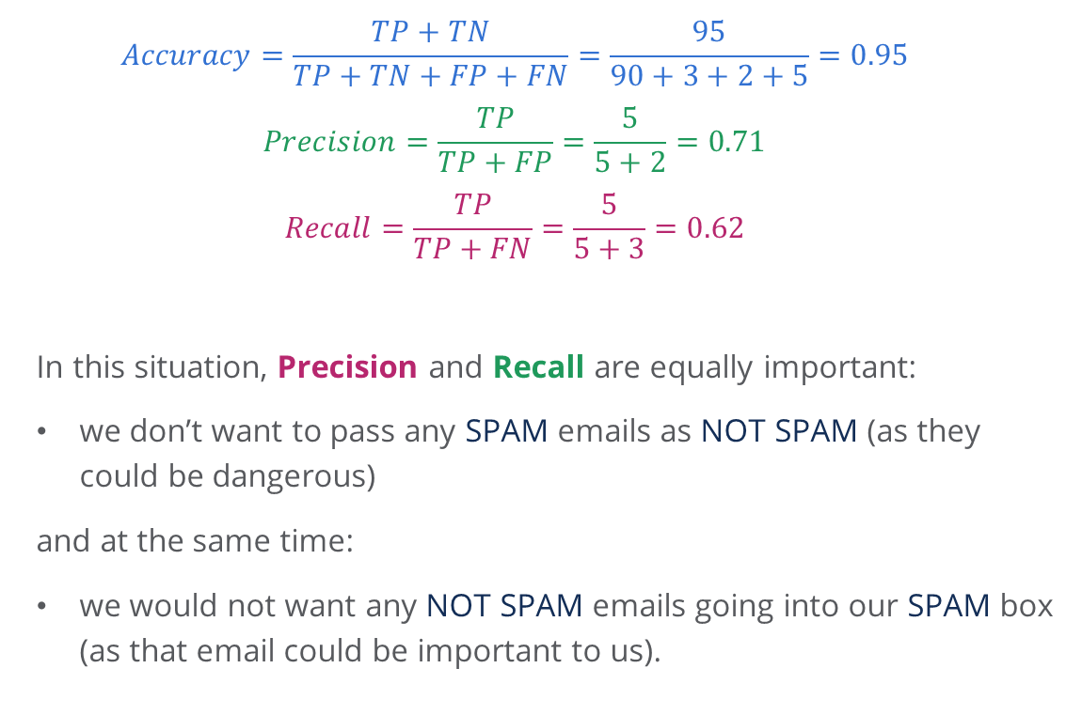
Evaluation Metrics Example
Consider an example where we have 100 emails and we use a model to predict whether an email is spam or not. Here SPAM emails is our positive class and NOT SPAM is our negative class.
$$Accuracy=\frac{TP+TN}{TP+TN+FP+FN}=\frac{95}{90+3+2+5}=0.95$$
$$Precision=\frac{TP}{TP+FP}=\frac{5}{5+2}=0.71$$
$$Recall=\frac{TP}{TP+FN}=\frac{5}{5+3}=0.62$$
In this situation, Precision and Recall are equally important:
we don’t want to pass any SPAM emails as NOT SPAM (as they could be dangerous)
and at the same time:
we would not want any NOT SPAM emails going into our SPAM box (as that email could be important to us).
Prediction
Not Spam
Spam
True Negative
False Positive
Not Spam
90
2
Actual
False Negative
True Positive
Spam
3
5

Slide 46
Precision Vs Recall
Accuracy works well for balanced classes (having roughly equal number of samples of every class)
Precision is a good choice of metric when we have imbalanced classes and we want to minimized false positives.
Recall is a good choice of metric when we have imbalanced classes and we want to minimize false negatives.
In tumour risk detection, we would want to reduce the number of False Negatives.
We cannot afford to miss any malignant samples in the data.
Recall would be the preferred metric here because it measures the proportion of actual malignant tumours that we detected.
Misclassifying a low risk tumour as risky is obviously not ideal, but is a secondary priority.
Ideally, a model with both a high recall and precision score would be preferred.

Slide 47
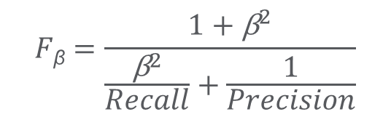
F_{β} –Score
F _{β} is a combined evaluation metric that balances precision and recall.
By choosing any value of β, we can modify our equation to control the weight of Precision and Recall in our calculations.
$$F\text{β}=\frac{1+{\text{β}}^{2}}{\frac{{\text{β}}^{2}}{Recall}+\frac{1}{Precision}}$$
focus on precision
B = 1
Focus on recall
B < 1
B > 1
B = 0
F₁ and F₂ are the most common iterations of F_{β} score

Slide 48
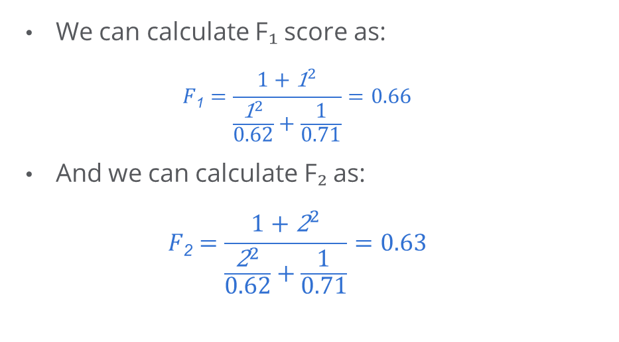
Practical Example F_{β}
Prediction
We can calculate F₁ score as:
$$F\text{1}=\frac{1+{\text{1}}^{2}}{\frac{{\text{1}}^{2}}{0.62}+\frac{1}{0.71}}=0.66$$
And we can calculate F₂ as:
$$F\text{2}=\frac{1+{\text{2}}^{2}}{\frac{{\text{2}}^{2}}{0.62}+\frac{1}{0.71}}=0.63$$
Not Spam
Spam
Not Spam
True Negative
False Positive
90
2
Actual
Spam
False Negative
True Positive
3
5
F₁ gives equal importance to both Precision and Recall
In this example, F₁ would be a relatively better choice as we prefer both Precision and Recall somewhat equally here.

Slide 49
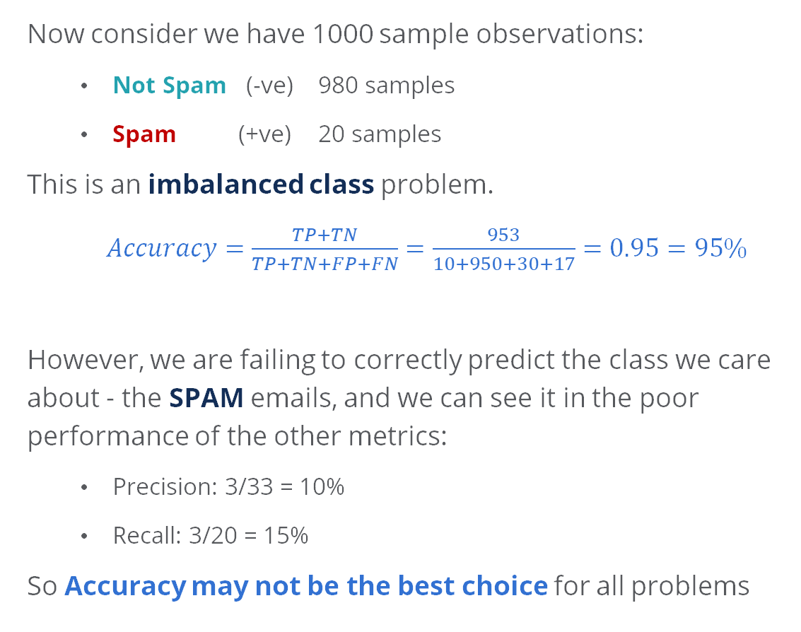
Is Accuracy the Best Choice?
Now consider we have 1000 sample observations:
Not Spam (-ve) 980 samples
Spam (+ve) 20 samples
This is an imbalanced class problem.
$Accuracy=\frac{TP+TN}{TP+TN+FP+FN}=\frac{953}{10+950+30+17}=0.95=95\%$
However, we are failing to correctly predict the class we care about - the SPAM emails, and we can see it in the poor performance of the other metrics:
Precision: 3/33 = 10%
Recall: 3/20 = 15%
So Accuracy may not be the best choice for all problems
Prediction
Not Spam
Spam
True Negative
False Positive
Not Spam
950
30
Actual
False Negative
True Positive
Spam
17
3

Slide 50
The ROC Curve
The Receiver Operating Characteristic (ROC) curve visualizes the model performance and is a useful way to evaluate the results of a binary classification model.
True Positive Rate Describes the proportion of actual positives that we correctly identified. Same as recall.
TPR
False Positive Rate
Describes the proportion of actual negatives that we flagged as positive.
Better
Random Classifier
$$TPR=\frac{True Positive }{True Positive+ False Negative}$$
$$FPR=\frac{False Positive}{True Negative+ False Positive}$$
FPR
Each classification model we create can be plotted as a curve on this chart.
The further the ROC curve from the random classifier (towards TPR), the better the model is at predicting overall results.
Notes:
In this video we’re going to introduce the ROC curve, which is a useful way to evaluate the results of a binary classification model. The ROC curve helps us see visually, how much better our model is than just guessing.
The ROC relies on two underlying variables called prediction percentages: The True Positive Rate and the False Positive Rate.
-The True Positive Rate describes the proportion of ACTUAL positives that we correctly identified. It is the same formula as Recall. -The False Positive Rate describes the proportion of ACTUAL negatives that we flagged as positive.

Slide 51
The ROC Curve - AUC
AUC stands for Area Under the Curve. It is calculated as the surface or area that sits underneath the curve.
Helps summarise the ROC curve into a single number between 0 and 1, to help compare different algorithms
Higher AUC (close to 1) means the model is better at separating classes.
A perfect model would display a square in order to maximize the area.
TPR
Perfect
Better
Random Classifier
FPR

Slide 52
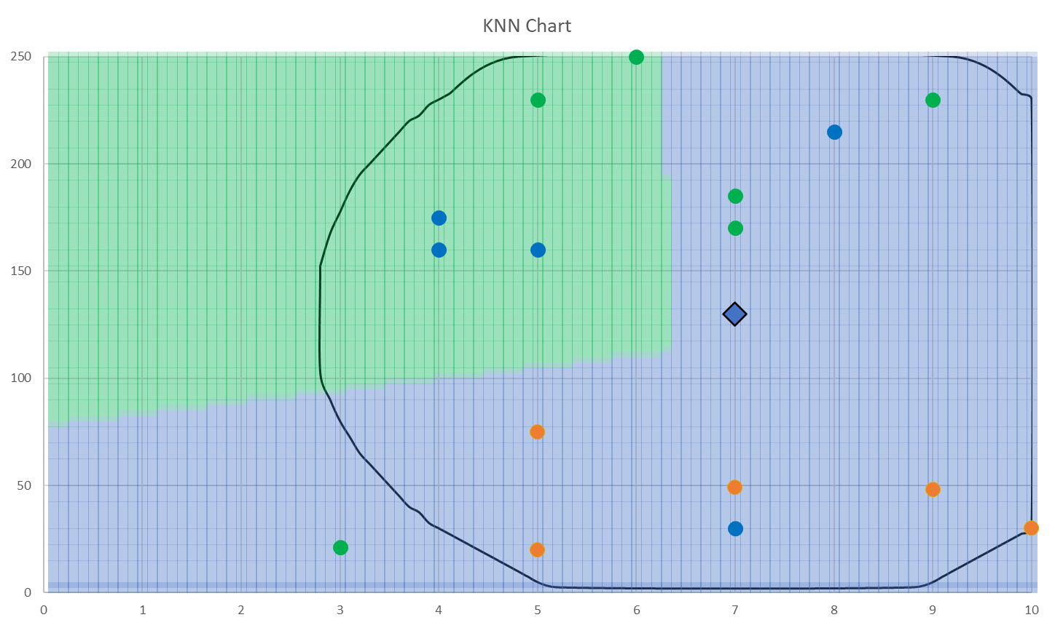
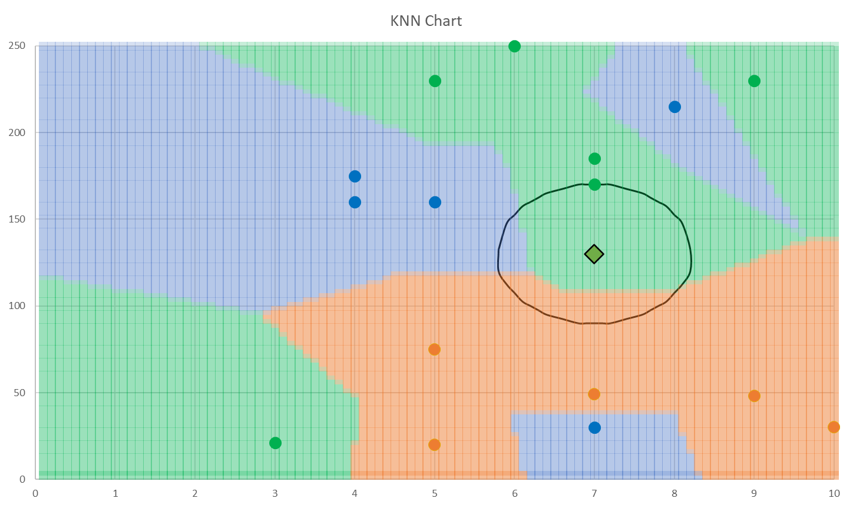
Overfitting Vs Underfitting
Underfitting and Overfitting are terms that helps us summarize the performance of a model.
Underfitting
Is too simple for the scenario
Does not perform well on the training data
Oversimplifies patterns in the data
Will not perform well on testing data
Overfitting
Learns the training data too well (effectively learns the answers)
Will perform very well on training data.
But is unable to look at the bigger picture and generalize trends
Will likely perform badly on testing (new) data

Slide 53
We’ve built a good working model, now what?
Often a model is the spark for follow up questions, such as:
To what extent can we explain the reasons why our model makes the predictions that it does?
What are the main drivers for making this class prediction?
What are the main drivers for predicting this customer will purchase my product?
What influences positively/negatively on that purchase prediction?
How large is the influence of each input variable?
How can we explain the difference between one prediction and the next?
Notes:
Most of the times building a great model is not very useful in itself.

Slide 54
Interpretability of Machine Learning Models
A model is interpretable if it can be understood by anyone without additional explanation.
Interpretability ensures that the model is reliable, fair, robust and reasonable
Basic models, like Linear models or Naïve Bayes models, are highly interpretable and user-friendly
A model is accurate is it can make higher quality predictions on average.
For better accuracy in models that use real-world data we tend to require more complex models (often less interpretable) like Neural Networks.
Naïve Bayes
Linear Regression
Decision Trees
Logistic Regression
Interpretability
SVMs
Random Forests
Neural Networks
Accuracy
We must consider the extent to which we are required to dissect and provide interpretable outputs.

Slide 55
Interpretability and Explainability
Interpretability
A model is interpretable if you can work out the simple cause and effect relationship between inputs and outputs with relatively simple logic.
What is happening?
Naïve Bayes
Linear Regression
Decision Trees
Logistic Regression
Random Forest
Neural Networks
Deep Neural Networks
Why is it happening?
Explainability
A model is explainable if we can fully dissect each part of the model and explain it’s role in the decision making process.
White Box Models are easy to interpret and explain.
Reinforces accountability and audit.
Black Box Models make it difficult to pin-point causality for a particular outcome.
Less helpful for accountability or audit.

Slide 56
Introduction to Feature Importance
Avg / Median
Range
Feature importance helps determine how well each of the individual features helps predict the overall outcome.
The higher the total importance, the more influence that feature has on what we want to predict.
This technique tends to be used in tree-based algorithms such as Decision Trees or Random Forests but can also be used more generally.
There are different types of feature importance depending on how we define importance e.g. number of times a feature is used to split a branch in a decision tree.
Genetics
Sedentary
Age
Smoker
Height
Weight
High
Low
Feature importance (across model iterations)
We can see genetics, age and being sedentary have high importance when predicting whether a tumor is malignant.
Strengths
Model learns better by prioritising important features
Training time and memory requirements reduces
Weaknesses
Mostly rely on approximations other than for linear models
Most methods cannot deal with high-dimensional data

Slide 57
Introduction to Partial Dependence Plots (PDP)
1.0
0.8
Partial Dependence Plots (PDP) show the marginal effect of independent feature(s) on model predictions
They shows whether the relationship between the outcome and predictor variable is linear, monotonic or more complex
Straight flat PDP indicates that the feature is not important.
When predicting malignant tumours – increase in age (>55) and genetic likelihood score (>0.5) means higher likelihood of tumour being malignant
0.6
Malignant Tumour Probability
0.4
0.2
Age
0.0
20
40
60
80
100
1.0
0.8
0.6
0.4
0.2
Genetic Likelihood
0.0
0.2
0.4
0.6
0.8
1.0
Strengths
The interpretation of the plots is intuitive and easy to understand
Weaknesses
Assumes independence in the features
Limited interpretability with more than 2 features
1.0
0.8
0.6
0.4
0.2
Height
0.0
0.2
0.4
0.6
0.8
1.0

Slide 58
Introduction to SHapley Additive exPlanations (SHAP)
SHAP values help explain the contribution each feature is making on an individual prediction.
When we are talking about individual observations, we are talking about local explainability.
Genetics
Sedentary
Age
Smoker
Height
Instead of asking:
How much is the prediction of a tumour being malignant driven by a persons age?
We would ask:
How much is the prediction of this patients tumour being malignant driven by the fact that she is over 65 years old?
Weight
0.05
0.10
0.15
0.20
0.25
SHAP Value
Genetics was the highest driver behind this positive prediction.
Strengths
Makes black-box models easy to explain to all audiences
Allows for decomposing of each prediction by all the features
Weaknesses
SHAP can be slow to plot
It is possible to create intentionally misleading interpretations that can hide biases

